Slide 1

Wired LANs: Ethernet
13.<number>
Copyright © The McGraw-Hill Companies, Inc. Permission required for reproduction or display.

Slide 2
13-1 IEEE STANDARDS
In 1985, the Computer Society of the IEEE started a project, called Project 802, to set standards to enable intercommunication among equipment from a variety of manufacturers. Project 802 is a way of specifying functions of the physical layer and the data link layer of major LAN protocols.
13.<number>

Slide 3

Figure 13.1 IEEE standard for LANs
13.<number>

Slide 4
13-2 STANDARD ETHERNET
The original Ethernet was created in 1976 at Xerox’s Palo Alto Research Center (PARC). Since then, it has gone through four generations. We briefly discuss the Standard (or traditional) Ethernet in this section.
13.<number>

Slide 5

Figure 13.3 Ethernet evolution through four generations
13.<number>

Slide 6

Figure 13.4 802.3 MAC frame
13.<number>

Slide 7

Figure 13.5 Minimum and maximum lengths
13.<number>

Slide 8

Note
Frame length:
Minimum: 64 bytes (512 bits)
Maximum: 1518 bytes (12,144 bits)
13.<number>

Slide 9

Figure 13.6 Example of an Ethernet address in hexadecimal notation
13.<number>

Slide 10

Figure 13.7 Unicast and multicast addresses
13.<number>

Slide 11
Note
The least significant bit of the first byte
defines the type of address.
If the bit is 0, the address is unicast;
otherwise, it is multicast.
13.<number>

Slide 12
Note
The broadcast destination address is a special case of the multicast address in which all bits are 1s.
13.<number>

Slide 13
Example 13.1
Define the type of the following destination addresses:
a. 4A:30:10:21:10:1A b. 47:20:1B:2E:08:EE
c. FF:FF:FF:FF:FF:FF
Solution
a. This is a unicast address because A in binary is 1010.
b. This is a multicast address because 7 in binary is 0111.
c. This is a broadcast address because all digits are F’s.
13.<number>

Slide 14

Figure 13.8 Categories of Standard Ethernet
13.<number>

Slide 15

Table 13.1 Summary of Standard Ethernet implementations
13.<number>

Slide 16
13-4 FAST ETHERNET
Fast Ethernet was designed to compete with LAN protocols such as FDDI or Fiber Channel. IEEE created Fast Ethernet under the name 802.3u. Fast Ethernet is backward-compatible with Standard Ethernet, but it can transmit data 10 times faster at a rate of 100 Mbps.
13.<number>

Slide 17

Figure 13.19 Fast Ethernet topology
13.<number>

Slide 18

Figure 13.20 Fast Ethernet implementations
13.<number>

Slide 19

Table 13.2 Summary of Fast Ethernet implementations
13.<number>

Slide 20
13-5 GIGABIT ETHERNET
The need for an even higher data rate resulted in the design of the Gigabit Ethernet protocol (1000 Mbps). The IEEE committee calls the standard 802.3z.
13.<number>

Slide 21

Figure 13.22 Topologies of Gigabit Ethernet
13.<number>

Slide 22

Figure 13.23 Gigabit Ethernet implementations
13.<number>

Slide 23

Table 13.3 Summary of Gigabit Ethernet implementations
13.<number>

Slide 24

Table 13.4 Summary of Ten-Gigabit Ethernet implementations
13.<number>

Slide 25
FDDI
13.<number>

Slide 26
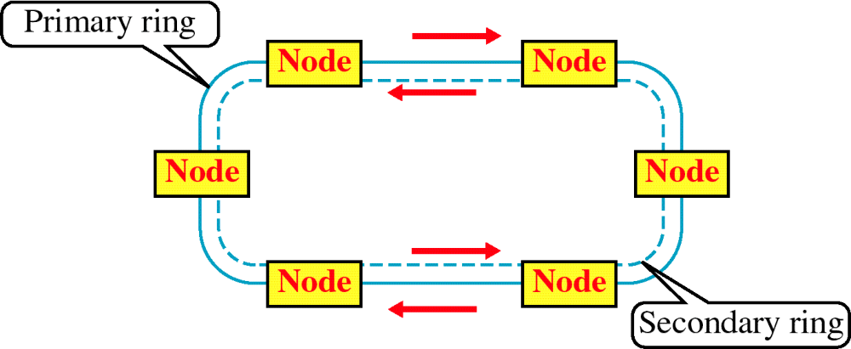
FIBER DISTRIBUTED DATA INTERFACE (FDDI)
13.<number>

Slide 27
SHARED MEDIA NETWORK LIKE ETHERNET (IEEE 802.3) & IBM TOKEN RING (IEEE 802.5)
100 Mbps SPEED
RUNS ON OPTICAL FIBER
AMERICAN NATIONAL STANDARDS INSTITUTE (ANSI) STANDARD
TOKEN RING NETWORK LIKE IEEE 802.5
TOKEN: A SPECIAL SEQUENCE OF BITS
TOKEN CIRCULATES AROUND THE RING
A STATION REMOVES THE TOKEN FROM RING BEFORE TRANSMISSION
AFTER TRANSMISSION, THE STATION RETURNS THE TOKEN TO THE RING
COLLISIONS ARE PREVENTED AS THERE IS ONLY ONE TOKEN IN THE RING
13.<number>

Slide 28
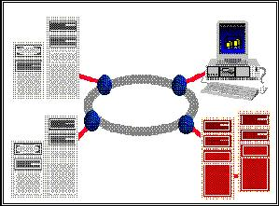
TOKEN RING NETWORK
13.<number>

Slide 29
FDDI LIMITATIONS
HIGH COST OF OPTICAL COMPONENTS REQUIRED FOR TRANSMISSION/RECEPTION OF SIGNALS (ESPECIALLY FOR SINGLE MODE FIBER NETWORKS)
MORE COMPLEX TO IMPLEMENT THAN EXISTING LOW SPEED LAN TECHNOLOGIES SUCH AS IEEE 802.3 AND IEEE 802.5
13.<number>

Slide 30
APPLICATIONS OF FDDI
OFFICE AUTOMATION AT THE DESKTOP
BACKBONES FOR FACTORY AUTOMATION
BACKEND DATA CENTER APPLICATIONS
CAMPUS LAN INTERCONNECTION
INTERCAMPUS BACKBONES OR METROPOLITAN AREA NETWORKS (MANs)
INTERCONNECTION OF PRIVATE BRANCH EXCHANGES (PBXS)
WORKGROUP AND DEPARTMENTAL LANS
INTEGRATED TRANSPORT FOR MULTIMEDIA APPLICATIONS
13.<number>

Slide 31
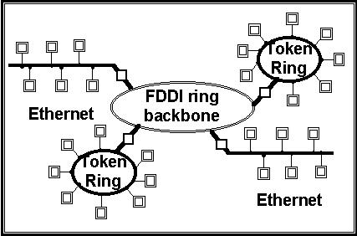
A FDDI BACKBONE NETWORK EXAMPLE
13.<number>

Slide 32
COMPARISON WITH OTHER NETWORKS
FEATURES | FDDI | ETHERNET | TOKEN RING
TRANSMISSION RATE | 125 MBAUD | 20 MBAUD | 8 & 32 MBAUD
DATA RATE | 100 MBPS | 10 MBPS | 4 & 16 MBPS
SIGNAL ENCODING | 4B/5B (80% EFFICIENT) | MANCHESTER (50% EFFICIENT) | DIFFERENTIAL MANCHESTER (50% EFFICIENT)
MAXIMUM COVERAGE | 100 KM | 2.5 KM | CONFIGURATION DEPENDENT
MAXIMUM NODES | 500 | 1024 | 250
MAXIMUM DISTANCE BETWEEN NODES | 2 KM (MULTIMODE FIBER) 40 KM (SINGLE-MODE FIBER) | 2.5 KM | 300 M (RECOMMENDED 100 M)
13.<number>

